Slide 1
Written by
Jackie Lunt
Senior mental health practitioner & psychotherapist
Karen Poole
Clinical psychologist
Alder Hey CAMHS
April 2020

Slide 2
Can we ‘play’ our way through this corona crisis?

Slide 3
So many things are uncertain at the moment.
We are hearing scary
things on the news
every day.
This can raise stress levels and anxiety for both parents and their children.

Slide 4
All of our usual routines are changed.
We are all experiencing
Change
upon
change
upon
change
upon
change…
.

Slide 5
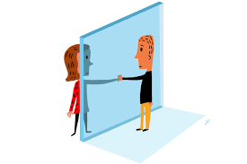
Children are not in school and are at home with their parents.
Most children are not having any direct contact with their grandparents, cousins, school friends, neighbours etc.
All our opportunities for direct social contact are dramatically reduced.

Slide 6
Most of us are really good at managing change. We have had lots of practice even with sudden ‘big’ changes. Remember that change that happened when you went from being not a parent to being a parent?
(Yes that was a biggie).
I want to remind you that you have survived that one.

Slide 7
The changes as consequences of the cornona virus crisis have happened very, very quickly.
And it’s a global thing too.

Slide 8
“We (all of us) are currently going through a collective traumatic experience. Trauma is often thought of as “too much, too fast”… which is exactly what’s happening. Of course you’re exhausted. Of course you’re afraid. Of course you’re overwhelmed. Of course you’re clinging to certainty in the midst of so much unknown. Of course you aren’t as productive, feeling foggy, or wondering how you can possibly go through so many waves of emotions all in the same day. This all makes so much sense in the context of our circumstances. Be gentle with yourself. Have compassion for your process. Give yourself grace. You are good, no matter how you’re are managing this completely new experience.”
Lisa Olivera

Slide 9
So it’s fair to say that we are all sailing in uncharted waters right now.
Because none of us have experienced anything like this before, we are having to find our way of getting through.

Slide 10
These changes mean that we are all at home together more often.
This is combined with having reduced opportunities to get outside and play/exercise.
Parents may be working and looking after the children.
AND parents are now ‘tasked’ with providing their children with some education!!!!!

Slide 11
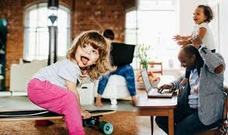
Home schooling expectation vs. reality…
Familiar?

Slide 12
So lets get one thing
straight…
Your child’s teacher spent at least three years at university developing their teaching skills. They are going to be much better at this than we are!

Slide 13
If our child’s teacher is not much better at this than us, then s/he needs to ask for a refund of university tuition fees right now!

Slide 14
Our job as parents is to provide children with food, shelter and meet health care needs. We also need to be providing emotional warmth, comfort and love. We don’t need to be perfect with these, we only need to be
‘good enough’.
Hooray!

Slide 15
This will be more difficult for parents to achieve when they themselves are stressed and experiencing so many changes in such a short period of time to almost every aspect of life as we know it.

Slide 16
We are all drawing on parts of ourselves that have never been tested like this before!

Slide 17
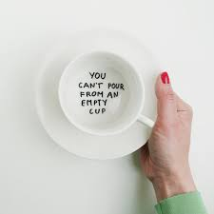
It is important that parents can take some time each day to access support with their own emotional wellbeing. As the saying goes
It is vital that parents keep their own emotional wellbeing ‘cup’ topped up.

Slide 18
There are many different ways to do this such as
talking with adult peers online or over the phone.
keeping an internal ‘check’ our own levels of ‘emotional regulation’.
noticing when we may be experiencing ‘overwhelm’ and need a mini ‘brain break’ for a while.

Slide 19
There are many different ways to do this such as
not putting too much pressure on yourself to formally educate your child/ren.
be realistic about what you are going to be able to achieve under these circumstances.
Remember this is not ‘easy’.

Slide 20
Young children do not have the capacity to make sense of all the changes that are happening. They don’t really grasp why you are now at home all the time and no one is going out anywhere.

Slide 21
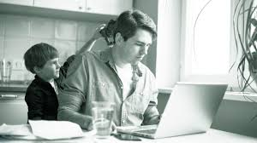
Even more confusing you may be spending time working from home and your child can’t understand why they can’t just go to you when they feel they want to.

Slide 22
When children (and adults!) experience this sort of psychological stress they may go back to earlier stages of development. This is known as ‘regressive behaviour’. This is not necessarily something that we would worry about.

Slide 23
It suggests that the child may have a bit of unfinished business from and earlier stage of development. They may want to play with toys that we would consider are for a much younger age or games that they played when they were younger. Let them do this.

Slide 24
The importance of play

Slide 25
This may be the opportunity they have been waiting for to be at home with their parent/s doing the things they used to enjoy at an earlier stage of their life. We encourage you to make use of this potential opportunity to connect with your child.

Slide 26
Connecting with our children through play

Slide 27
We can also help children manage their levels of emotional regulation.
There are lots of ways to do this. Here are a few ideas.

Slide 28
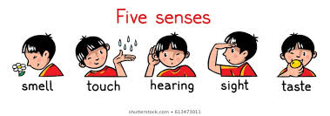
‘Changing the field of view’
by going outside, out onto the balcony (or if neither is possible looking out of the window)
Ask your child what they can see, hear, smell, feel and taste. This ‘sensory focussing’ helps to focus the mind into the here and now and lowers internal stress chemical levels.

Slide 29
‘Physical Activity’
Give children plenty of opportunity to be active. Being physically active and moving the bigger muscles in the body can have a calming effect on the mind.
Children who find it difficult to remain calm will benefit from having the opportunity to safely let this out via body movement.
Regular short breaks to move about and be physical can help children stay within an emotional comfort zone.

Slide 30
Use the idea of
‘prescribing the behaviour’
So for example - if you have a child who hits out frequently you may give them something soft to throw into a bowl and have some fun with this. You may use cotton wool balls or scrunched up balls of newspaper etc.
Everyone can join in with this.

Slide 31
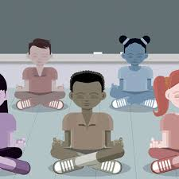
‘Breath control’
We know that the ‘out breath’ is
the relaxation breath.
Anything that makes the out breath longer than the ‘in breath’ will take you towards a more relaxed inner state.
Simply by extending the length of the outward breath we can begin to lower the levels of stress chemicals in the body.

Slide 32
‘Door breathing’
… yes honestly door breathing!

Slide 33
Notice your breath. If possible breath in and out through your nose. Try to completely focus on the door and your breath. Keep breaths in and out at the same speed.
Focus your vision on the top left corner of the door. Breath in as you move your gaze, slowly, along the top of the door.
As your gaze arrives at the top right corner pause for a second before moving your gaze down towards the bottom right corner. As you are doing this breath out.

Slide 34
As your gaze arrives at the bottom right corner of the door pause for a second.
Move your gaze slowly to the bottom left of the door whilst breathing in.
As you arrive at the bottom left corner of the door pause for a second before slowly moving your gaze up towards the top left corner of the door. Breath out as you do this.

Slide 35
Repeat this at least 3 times to start to lower internal stress chemicals.
Older children and adults may benefit from doing this for longer periods of time. This is a meditation.
The more you do this the more relaxed you are likely to feel. Remember being stressed can be a habit and it takes time to change to a more relaxed way of living.

Slide 36
This ‘door breathing’ exercise is a meditation. If you found this useful you can find loads more by simply doing a google search.
We are almost at the end of this workshop.
We would like to thank you for your participation and wish you good luck in these difficult times.
On the last page of this work shop we give you the titles of some really useful books that will help you take ideas of playful parenting further.

Slide 37
Suggested further reading.
Fortune, J. (2018). 15 Minute Parenting. Gill Books; Dublin.
Norris, v. & Rodwell, H. (2017). Parenting with Theraplay. Jessica Kingsley; London.
Webster-Stratton, C. (2005). The Incredible Years. A Trouble-Shooting Guide for Parents of Children Aged 2 – 8 years. Incredible Years; Seattle.

